Slide 1


Data Visualization through Power BI
- Power BI Dashboards

Slide 2
Session-III Plan
Introduction to PBI.
Walk through PBI.
Loading Excel and CSV file.
Creation of bar chart.
Assessment
Summary and Interaction.

Slide 3

Introduction to POWER BI
Power BI is a cloud-based business analysis and intelligence service by Microsoft.
We can use the datasets imported in Power BI for data visualization and analysis by making sharable reports, dashboards, and apps.
Power BI is a user-friendly tool offering impressive drag-and-drop features and self-service capabilities.

Slide 4
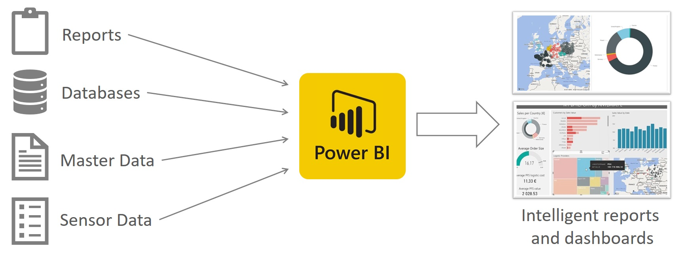
Workflow

Slide 5
History of Power BI
Power BI is a Microsoft’s product initially released on 11th July 2011. It was originally designed and created by Ron George in 2010, who released it with the name “Project Crescent”. Later in September of 2013, Microsoft changed the name to Power BI and launched it for the public.

Slide 6
Features
Stacked bar chart
Stacked column chart
Clustered bar chart
Scatter chart
Pie chart
Map
Gauge chart, etc.

Slide 8
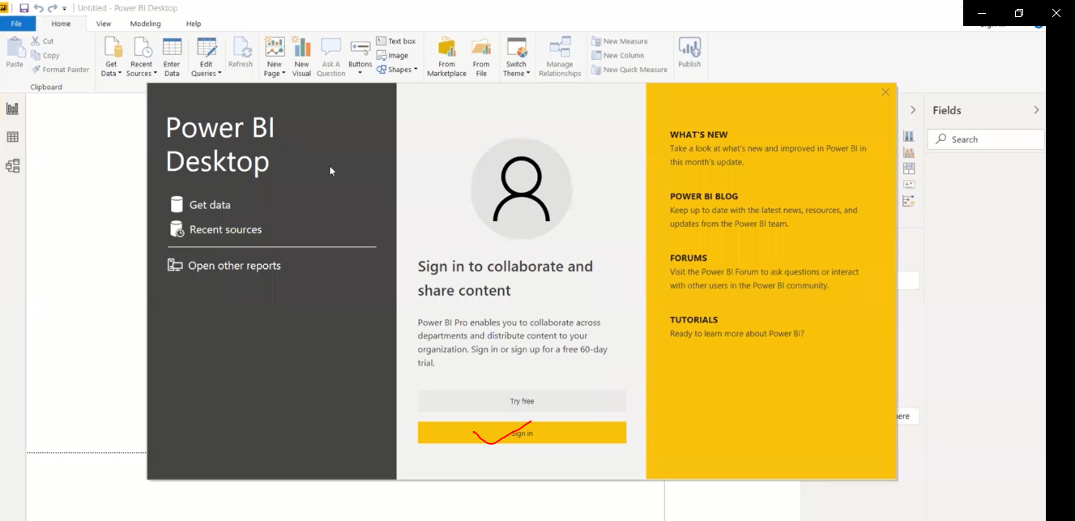
Launch the Application and Login

Slide 9
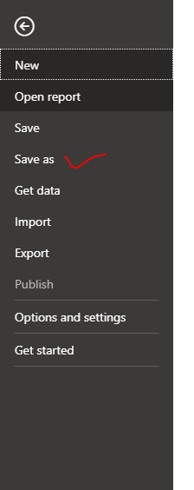
Save the template ( Untitled to Specific name)
File> Save as > Name

Slide 10
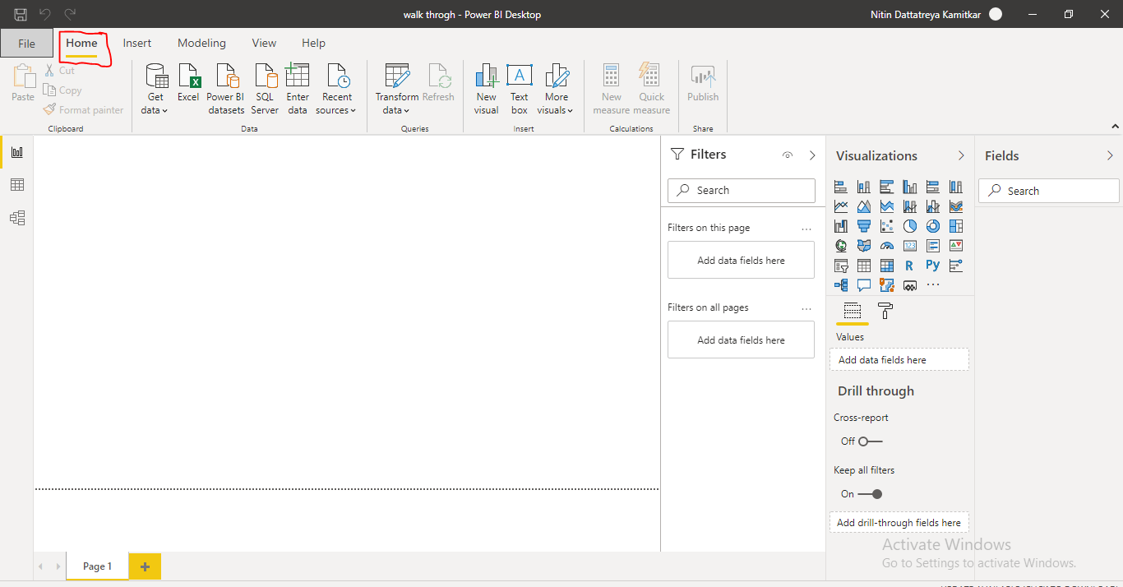
HOME

Slide 11
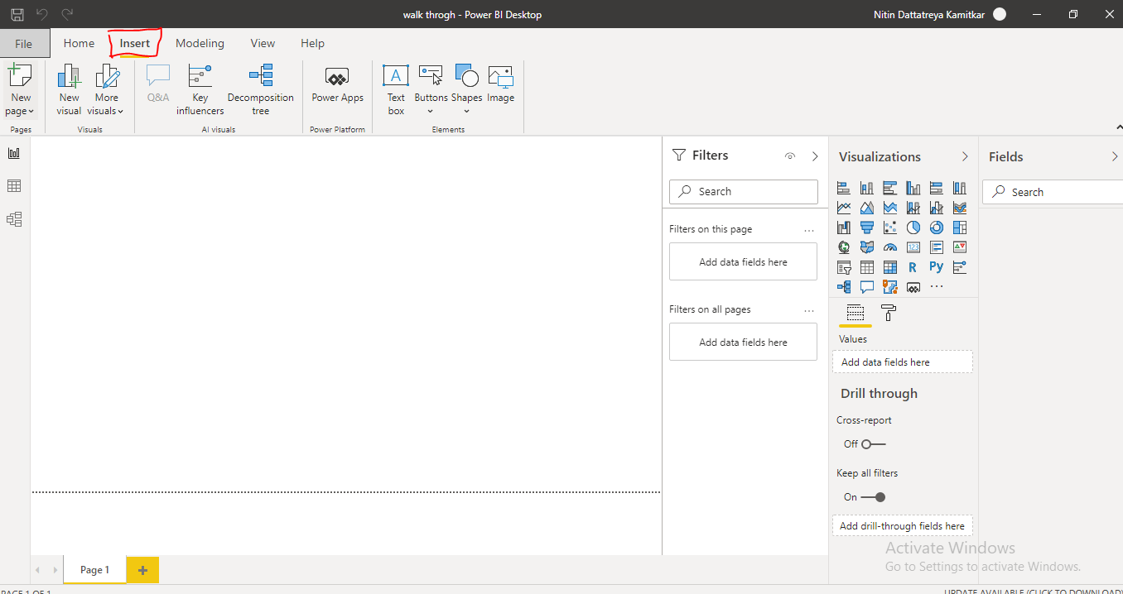
INSERT

Slide 12
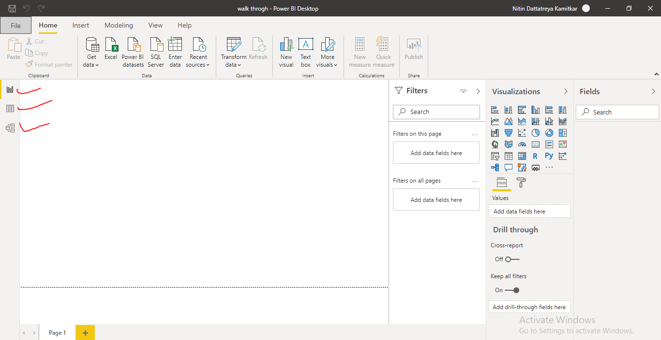
REPORT, DATA AND MODEL

Slide 13
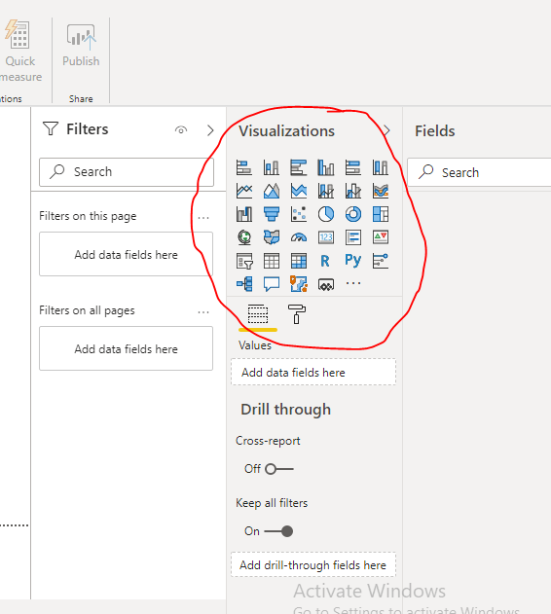
VISUALIZATION CHARTS

Slide 14
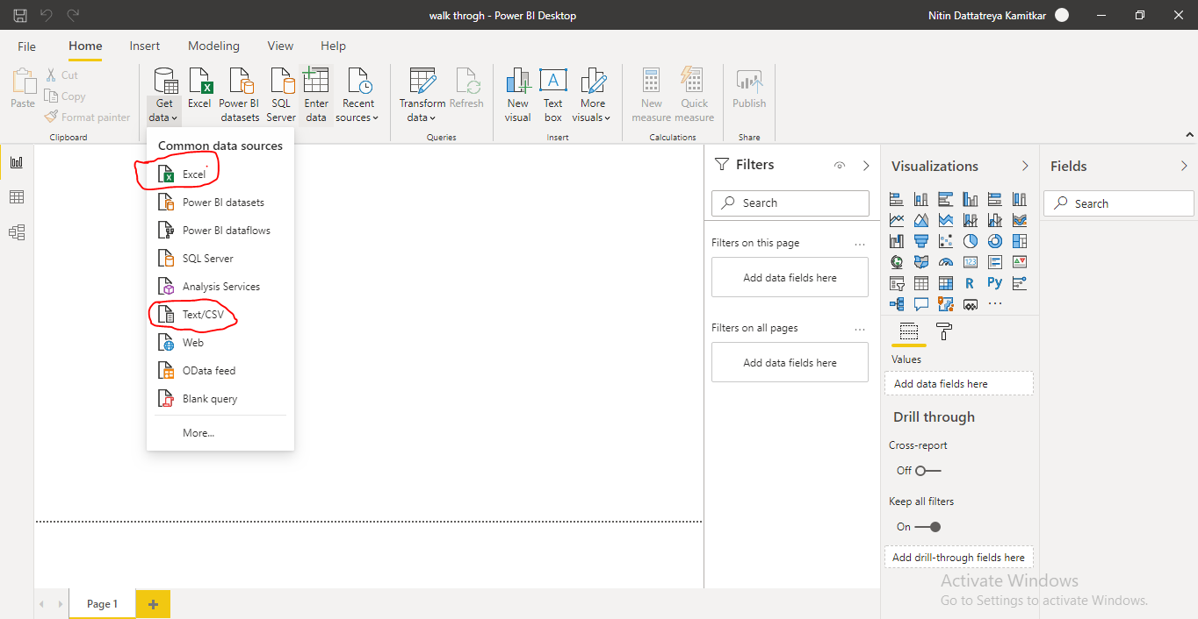
Loading Data >Excel /CSV file.
Go to get data select the type of file and location where data is stored.

Slide 15
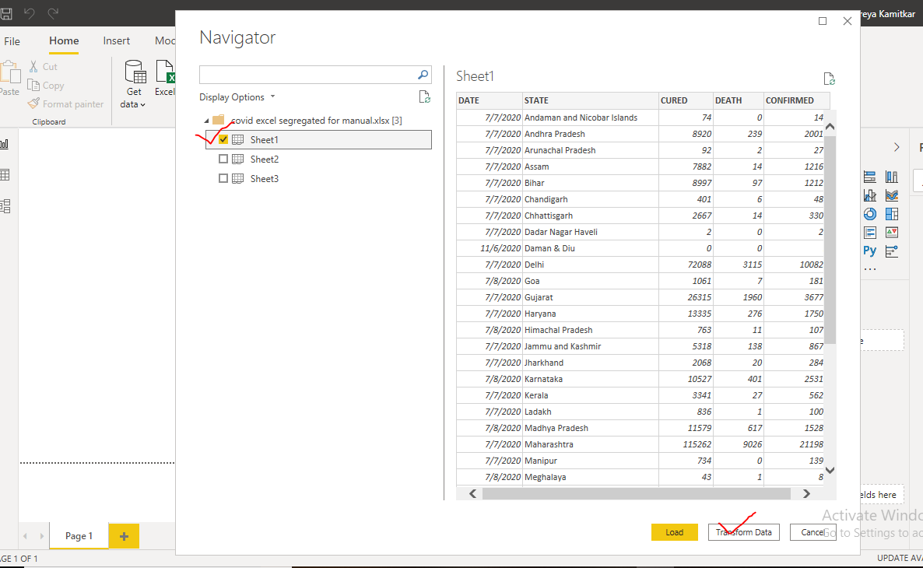
Transforming the Data
After selecting the file we will get navigator from which the particular data sheet to be selected
It is the process where data can be edited or refined or altered through power query editor.

Slide 16
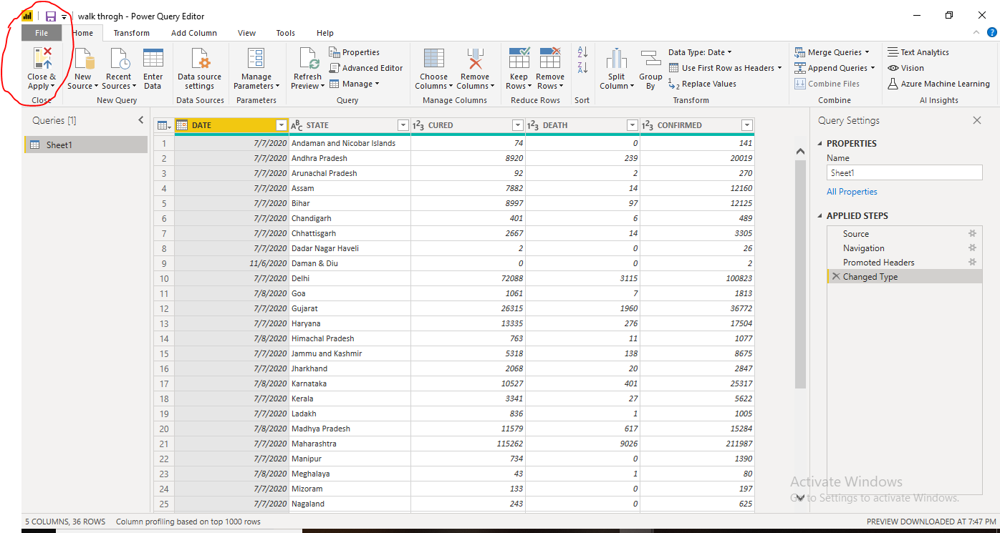
If any modifications done then apply and close.

Slide 17
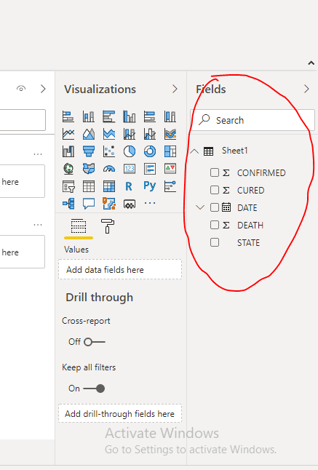
Once data is successfully imported , it will show in the fields with name of the sheet.

Slide 18
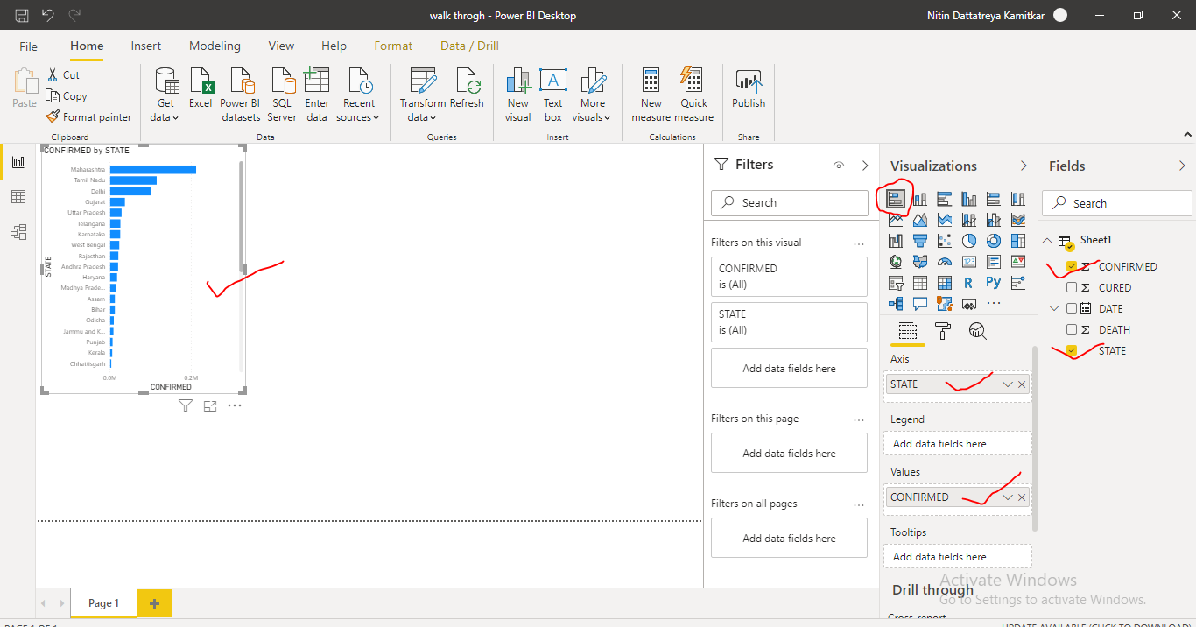
Creating Chart and Restyling
Click on the type of chart to plot and select the variables from sheet.

Slide 19
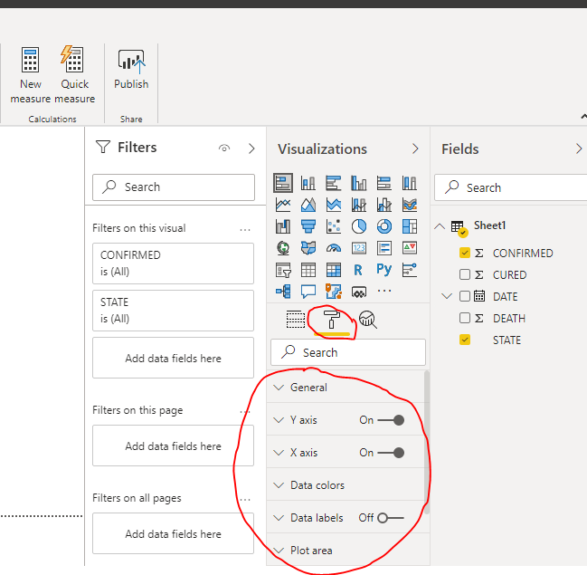
chart style and format can be changed as per requirement by clicking on FORMAT option

Slide 20
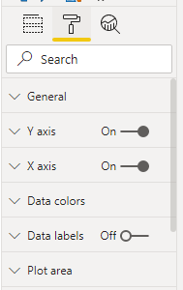
We can change color, Unit, axis, label and Units of data so on….

Slide 21
Practice Session
Put chart for >>state v/s Death
Put Chart for >> state v/s Cured

Slide 22
INTERACTION –

